Slide 1
def PicHunter {
PicHunter.py
README.md
[Don’t waste space]
}
Python

Slide 2
Identified ‘Problems’ {
01
02
03
PicHunter.py
README.md
Waste of storage
< Duplicate pictures >
Waste of time
< Difficult to find them >
Mental breakdown
< Annoying >
}
Python

Slide 3
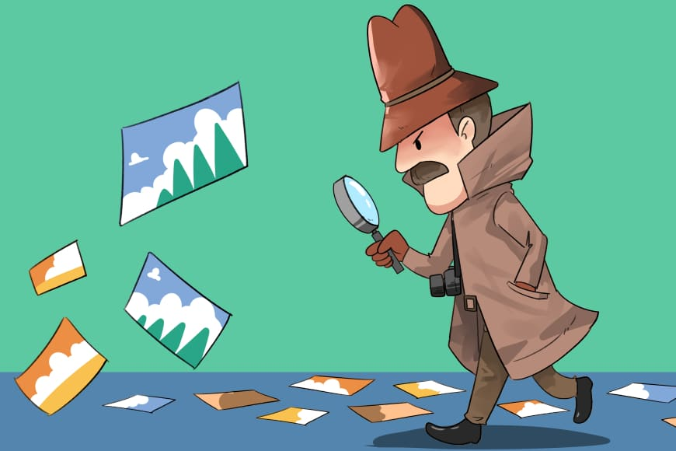

Slide 4
Statistics {
23 hours / week
PicHunter.py
README.md
< Average time spent on social media >
}
Python

Slide 5

Solution; {
PicHunter.py
README.md
Find duplicates
Delete
Happy Users
}
Python

Slide 6
Team: - Ioan-Teofil Sturzoiu - Daria Traicu - Maslaev Andra - Mihai Brezniceanu
PicHunter.py
README.md
Python

